Slide 1
Foundations of Planning

Slide 2
Planning: An Overview
Planning is a particular kind of decision making that addresses the specific future that managers desire for their organizations.
Planning is the major activity in the management process. It is a locomotive that drives a train of organizing, leading and controlling activities.
Planning is not a single event, with a clear beginning and end. It is an ongoing process that reﬂects and adapts to changes in the environment surrounding each organization.
Deciding on actions and responses to others’ actions is the continual planning challenge for the managers.
Strategic management is an ongoing practice of establishing a broad program of organizational goals and the means to achieve them.

Slide 3
Why Do Managers Plan?
It provides sense of direction (From where we are to where we want to be)
It reduces uncertainty
It minimizes waste and redundancy
It establishes the goals or standards used in controlling

Slide 4
What About Goals?
Goals (Objectives) are desired outcomes or targets.
They guide management decisions and form the criteria against which work results are measured.
There could be two types of goals:
Stated Goals: Official statements of what an organization says and what it wants its various stakeholders to believe its goals are.
Ex: Vision & Mission
Real Goals: Goals that an organization actually pursues as defined by the actions of its members.
Ex: Objectives

Slide 5
And Plans?
Plans are documents that outline how goals are going to be met.
They usually include the resource allocations, scheduling and other necessary actions to accomplish the goals.
There are various types of plans based on:
Breadth: Strategic and Operational
Time frame: Long term and Short term
Specificity: Directional and Specific
Frequency of use: Single use and standing

Slide 6
Types of Plans
Strategic plan (SP): Plans that apply to an entire organization and establish the organization’s overall goals.
Operational plan (OP): Plans that encompass a particular operational area of an organization.
Long term plan: Plans with a time frame beyond three years (SP).
Short term plan: Plans covering one year or less (OP).
Directional plan: Plans that are ﬂexible and that set out general guidelines (SP).
Specific plan: Plans that are clearly defined and that leave no room for interpretation (OP).

Slide 7
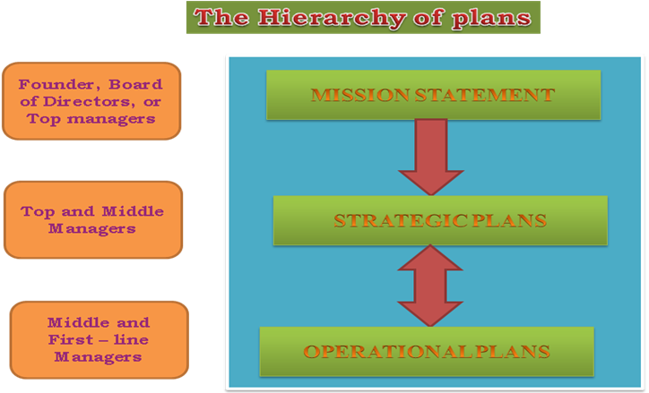

Slide 8
The Hierarchy of Organization Plans
Mission statement is a broad goal based on manager’s assumptions about the organization’s purpose, competencies, and place in the world. It is a relatively permanent part of an organization’s identity and can do much to unify and motivate members of the organization.
Organizations are typically managed according to two types of plans.
Strategic plans are designed by high-­‐ranking managers and define the broad goals for the organization. They deal with relationships between people at an organization and people acting at other organizations.
Operational plans contain details for carrying out, or implementing, those strategic plans in day-­‐to-­‐day activities. They deal with people within one organization.

Slide 9
Strategic & Operational Plan
Strategic and operational plans diﬀer in three major ways:
Time Horizons
Strategic plans tend to look ahead several years or even decades.
For operational plans, a year is often the relevant time period.
Scope
Strategic plans aﬀect a wide range of organizational activities, whereas operational plans have a narrow and more limited scope.
The number of relationships involved is the key diﬀerence here. Hence it is distinguished as strategic goals and operational objectives.
Degree of Detail
Often strategic goals are stated in terms that look simplistic and generic. But this breadth is necessary to direct people at organizations to think of the whole of their organization’s operations.
On the other hand, operational plans, as derivatives of strategic plans, are stated in relatively finer detail.

Slide 10
The Evolution of the Concept of Strategy
Strategy as the Grand Plan
The concept of strategy is ancient. The word itself comes from the Greek word strategeia, which means the art or science of being a General.
Eﬀective Greek generals needed to lead an army, win and hold territory, protect cities from invasion, wipe out the enemy and so forth.
Each kind of objective required a diﬀerent deployment of resources. Likewise, an army’s strategy could be defined as the pattern of actual actions that it took in response to the enemy.
Eﬀective Generals had to determine the right liens of supply, decide when to fight and when not to fight, and manage the army’s relationship with citizens, politicians and diplomats.
Eﬀective Generals not only had to plan but had to act as well. The concept of strategy had both a planning component and a decision making or action component. Taken together these two concepts form the basis of the ‘grand’ strategy plan.

Slide 11
The Evolution of the Concept of Strategy
The Rise of Strategic Management
Since War II, the idea emerged that strategic planning and acting on those plans constitute a separate management process, the process called as strategic management.
In 1962, business historian Alfred D Chandler proposed that ‘strategy’ be defined as: The determination of the basic long term goals and objective of an enterprise, and the adoption of courses of action and the allocation of resources necessary or carrying out these goals.
In other words, it plans for how an organization will do what it’s in business to do, how it will compete successfully, and how it will attract and satisfy its customers in order to achieve its goals.

Slide 12
The Strategic Management Process
A six step process that encompasses strategic planning, implementation and evaluation.
Identify the organization’s current mission, goals and strategies
Performing SWOT analysis: external opportunities & threats and
internal analysis – strengths & weaknesses
Formulating strategies
Implementing strategies
Evaluating results
analysis –

Slide 13
The Strategic Management Process
Strategic management provides a disciplined way for managers to make sense of the environment in which their organization plans, and then to act. In broad terms, two phases are involved:
Strategic planning is the name we customarily give to the sense making activity. This includes both the goal setting and the strategy formulation processes.
Strategy implementation is the name we customarily give to actions based on that kind of planning. This stage includes administration and strategic control stages.

Slide 14
The Strategic Management Process
In its synthesis, Hofer and Schendel focused on four key aspects of strategic management.
The first is, Goal Setting.
The next step is Strategy Formulation based on these goals.
Then to implement the strategy, there is a shift from analysis to Administration -­‐ the task of achieving predetermined goals. Key factors at this stage are the organization’s internal “political” processes and individual reactions, which can force the revision of strategy.
The final task, Strategic control, gives managers feedback on their progress. Negative feedback of course, can touch oﬀ a new cycle of strategic planning.

Slide 15
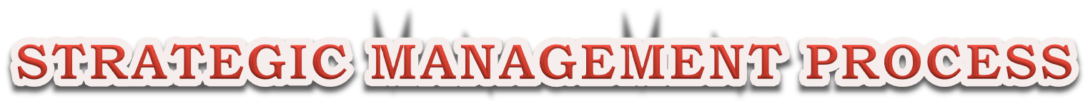























 | GOAL SETTING
Strategic Planning
 | STRATEGY FORMULATION
 | ADMINISTRATION
Strategy Implementation
 | STRATEGIC CONTROL

Slide 16
Types of Organizational Strategies
Corporate Strategy
Competitive Strategy
Functional Strategy

Slide 17
Corporate Strategy
Corporate level strategy is formulated by top management to oversee the interests and operations of organizations made up of more than one line of business.
It specifies what businesses a company is in or wants to be in and what it wants to do with those businesses.
This is based on company’s vision and mission. The major questions at this level are these:
What kinds of business should the company be engaged in?
What are the goals and expectations for each business?

Slide 18
Corporate Strategy
There are three types of corporate strategy:
Growth Strategy: A corporate strategy that’s used when an organization wants to expand the number of markets served or products oﬀered, either through its current businesses or through new businesses.
Stability Strategy: A corporate strategy in which an organization continues to do what it is currently doing.
Renewal Strategy: A corporate strategy designed to address declining performance. This has two types:
Retrenchment Strategy – Used for minor problems.
Turnaround Strategy – Used for serious problems.
Renewal strategy is typically used to cut costs, restructure organizational operations and revitalize resources.

Slide 19
Matching Structure and Corporate Strategy – Growth Strategy
According to Chandler, organizations pass through three stages of development, moving from a unit structure, to a functional structure, and then to a multidivisional structure.
At first, organizations are small. There is usually a single location, a single product, and a single entrepreneurial decision maker.
As an organization grows, however, increased volume and additional locations eventually create new challenges. The organization then becomes a unit ﬁrm, with several field units and an administrative office to handle coordination, specialization, and standardization among the units.
The next step is vertical integration. The organization keeps the original product but broadens its scope and strives for economies of scale by acquiring a supplier of raw materials and components or a distributor of finished goods.
However, vertical integration creates new problems in moving goods and materials through the organization’s various functions. Therefore, the organization evolves into a functional organization, with finance, marketing, production, and other subdivisions and formalized budgeting and planning systems.
In the third stage, an organization expands into diﬀerent industries and diversifies its products. This phenomenon poses a significant new challenge: selecting products and industries in which to invest the organization’s capital. The result is the multidivisional ﬁrm, which operates almost as a collection of smaller businesses.

Slide 20
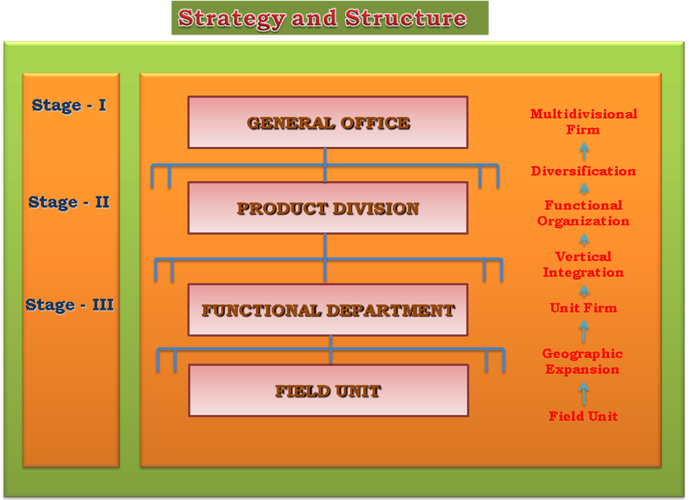

Slide 21
The Corporate Portfolio Matrix
The collection or portfolio of businesses can be managed using a matrix; this matrix is rational and analytical, is guided primarily by market opportunities, and tends to be initiated and controlled by top management only.
When all the business units have been evaluated, an appropriated strategic role is developed for each unit with the goal of improving the overall performance of the organization.
One of the best-­‐known examples of a corporate portfolio matrix is the portfolio framework advocated by the Boston consulting Group. This frame work is known as the BCG Matrix.
This matrix provides a framework for understanding diverse businesses and helps managers establish priorities for allocating resources.
The BCG approach to analyzing a corporate portfolio of businesses focuses on three aspects of each particular businesses unit: its sales, the growth of its market, and whether it absorbs or produces cash in its operations.
Its goal is to develop a balance among business units that use up cash and those that supply cash.

Slide 22















The Corporate Portfolio Matrix
STAR
Modest
+ or – Cash flow
QUESTION MARK
Large
Negative Cash flow
HIGH
MARKET GROWTH RATE
CASH COW
Large
Positive Cash flow
DOG
Modest
+ or – Cash flow
LOW
HIGH
LOW
RELATIVE MARKET SHARE

Slide 23
Competitive Strategy
An organizational strategy for how an organization will compete in its businesses is competitive strategy.
It deals with questions such as:
How will the business compete within its market? What products/services should it oﬀer?
Which customers does it seek to serve?
How will resources be distributed within the business?
Here each business will have its own competitive strategy.
Those single businesses that are independent and formulate their own competitive strategies are called strategic business units (SBUs).
In this system of organizations various business activities that produce a particular type of product or service are grouped and treated as a single business unit.
The corporate level provides a set of guidelines for the SBUs which develop their own strategies on the business unit level.

Slide 24
Choosing A Competitive Strategy – Five Forces Model
A well known approach to competitive strategy is Michael Porter’s “five forces” model.
In porter’s view, an organization’s ability to compete in a given market is determined by that organization’s technical and economic resources, as well as by five environmental “forces”, each of which threatens the organization’s venture into a new market.
Porter’s five forces exhibits all relationships between the managers at a given organization and people acting at other organizations.
These five forces are:
Threat of new entrants
Bargaining power of buyers (customers)
Bargaining power of suppliers
Threat of substitute products
Rivalry among competitors

Slide 25








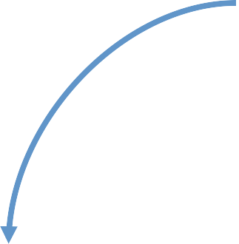
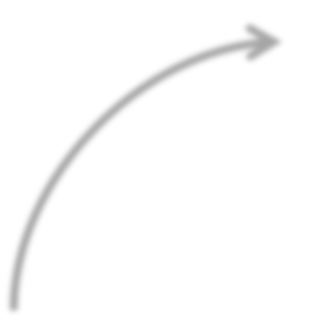

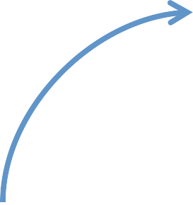


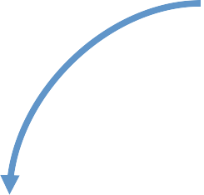














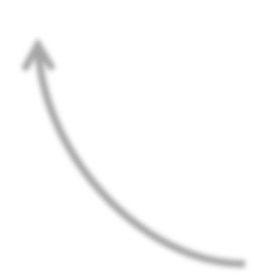





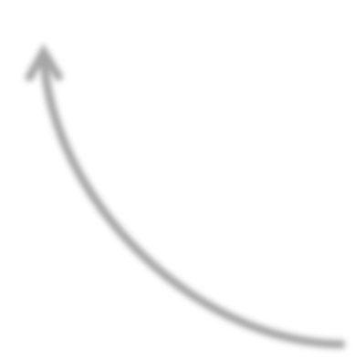
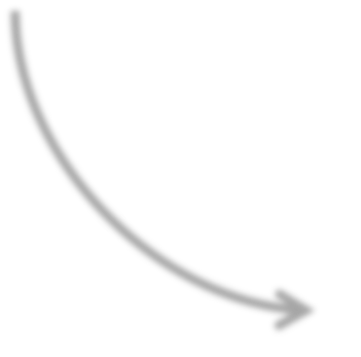

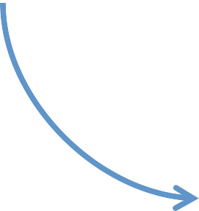

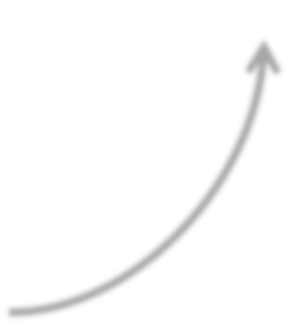
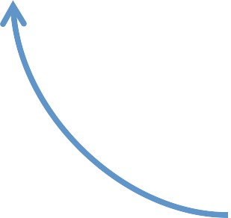






Threat of new entrants
Bargaining power of suppliers
THE INDUSTRY
Jockeying for position among current
competitors
Bargaining power of customers
Threat of Substitute products or services

Slide 26
Functional Strategy
Functional strategies are the strategies used by an organization’s various functional departments to support the organization’s competitive strategy.
Functional strategies create a framework for managers in each function -­‐ such as marketing or production to carry out business unit strategies and corporate strategies.
This functional strategy completes the hierarchy of strategies.
Operational plans follow from functional strategies.

Slide 27




















MULTIBUSINESS CORPORATION
STRATEGIC BUSINESS UNIT
STRATEGIC BUSINESS UNIT
STRATEGIC BUSINESS UNIT
RESEARCH & DEVELOPMENT
PRODUCTIVITY
/ OPERATIONS
MARKETING
FINANCE
Corporate – level Strategy
Business unit Strategy
Functional – level Strategy

Slide 28





CORPORATE STRATEGY
BUSINESS UNIT STRATEGY
FUNCTIONAL – LEVEL STRATEGY
STRATEGIC CONTROL

Slide 29
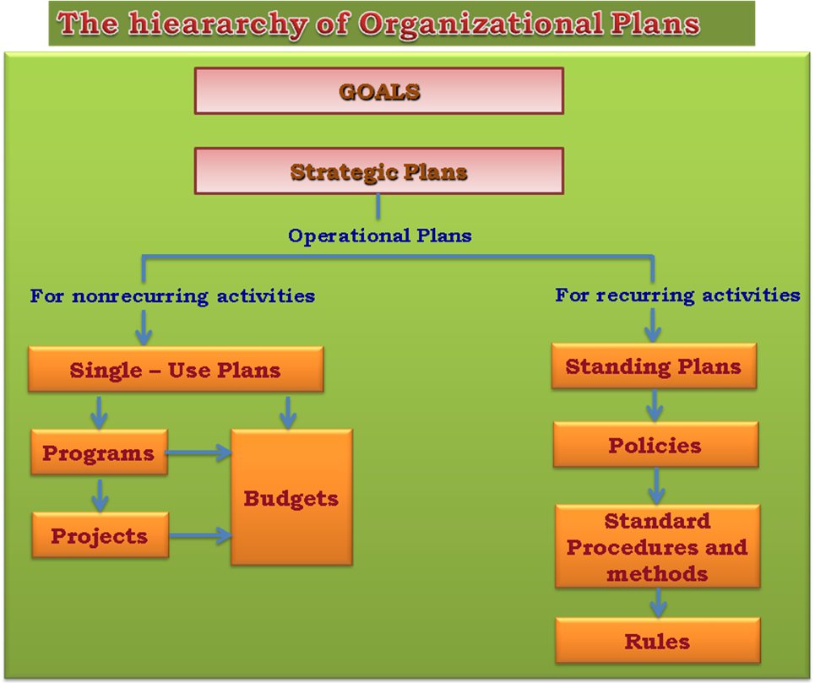
Types of Operational Plan
Single use plan: A one time plan specifically designed to meet the needs of a unique situation.
Standing plan: Ongoing plans that provide guidance for activities performed repeatedly.

Slide 30
Single Use Plans
Program: A single use plan that covers a relatively large set of organizational activities and specifies major steps, their order and timing, and the unit responsible for each step (Ex: Manufacturing Volvo bus).
Project: The smaller and separate portions of the programs; they are limited in scope and contain distinct directives concerning assignments and time (Ex: Chassis Engine, Exteriors, Interiors, etc.).
Budget: Formal quantitative statements of the resources allocated to specific programs or projects for a given period (Fund allocation to various projects).

Slide 31
Standing Plans
Policy: Establishes general guidelines for decision making (Ex: Placement policy).
Procedure: Contains a series of sequential steps for handling a well structured problem that occur regularly (Ex: Eligibility criteria, orientation, interview).
Rules: An explicit statement that tells managers what can or cannot be done (Ex: Dress code).

Slide 32
Management By Objectives
Management by objectives (MBO) goes beyond setting annual objectives for organizational units to setting performance goals for individual employees.
MBO refers to a formal set of procedures that begins with goal setting and continues through performance review.
It is a process of setting mutually agreed upon goals and using those goals to evaluate employee performance.
Performance appraisals are conducted jointly on a continuous basis, with provisions for regular periodic reviews.
Managers at every level help set objectives for those at levels higher than their own, in the belief that this would give them a better understanding of the broader strategy of the company and how their own specific objectives relate to the overall picture.

Slide 33
The Decision Making Process
Decision is a choice from two or more alternatives and decision making occurs as a reaction to a problem.
Here, a problem is an obstacle that makes achieving a desired goal or purpose difficult.
A discrepancy always exists between the current state of aﬀairs and some desired state.
Every information (input) in this process needs to be evaluated.
Input data needs to be screened, processed and interpreted. There are three types of Decision Making Process:
The Rational Model
Bounded Rationality
The Role of Intuition

Slide 34
The Rational Model
This is characterized by making logical, consistent and value maximizing choices with in specified constraints.
These decisions follow a eight step rational decision making model. They are:
Identifying a problem
Identifying decision criteria
Allocating weights to the criteria
Developing alternatives
Analyzing alternatives
Selecting an alternative
Implementing the alternative
Evaluating decision eﬀectiveness

Slide 35
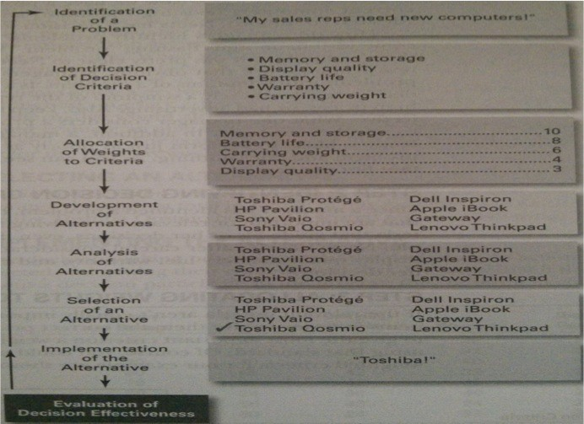
The Rational Model

Slide 36
Bounded Rationality
This is rational as well, but limited (bounded) by an individual’s ability to process information.
The process of making decisions here is done by constructing simplified models that extract the essential features from problems without capturing all their complexity.
This is because human mind cannot formulate and solve complex problems with full rationality, we operate with in the confines of bounded rationality.
When one has made alternatives, we review them only until we identify one that is satisfice – To accept solutions that are ‘good enough’.

Slide 37
The Role of Intuition
This decision is made on the basis of experience, feelings and accumulated judgment.
It looks at the big picture and usually engages the emotions (feelings that may not be rational in approach).
Intuition doesn’t operate in opposition to rational analysis, rather the two complement each other.
This can be a powerful force in decision making. The types of intuition based decision making are:
Experience based
Aﬀect initiated
Cognitive based
Values or ethics based
Subconcious mental processing

Slide 38
Types of Decisions
Structured Problems and Programmed Decisions
Structured problem is a straight forward, familiar, and easily defined problem.
Programmed decisions is a repetitive decision that can be handled using a routine approach.
These are made in accordance with policies, procedures, or rules that simplify decision making in recurring situations by limiting or excluding alternatives.
Ex: Minor matters such as the return of merchandise that can be handled by a set procedure.

Slide 39
Types of Decisions
Unstructured Problems and Nonprogrammed Decisions
Unstructured problem is a new or unusual problem for which information is ambigous or incomplete.
Nonprogrammed decision is a unique and nonrecuring decision that requires a custom made solution.
If a problem has not come up often enough to be covered by a policy or is so important that it deserves social treatment it must be handled as a non-­‐programmed decision.
Ex: How to allocate an organization’s resources, what to do about a failing product line, how community relations should be improved.
More important decisions, such as the location of a new retail outlet, require a non-­‐programmed decision, a specific solution created through a less structured process of decision making and problem solving.

Slide 40
Decision Making Conditions
All decisions involve future events, managers must also learn to analyze the certainty, risk and uncertainty associated with alternative courses of action.
Certainty: A situation in which a decision maker can make accurate decisions because all outcomes are known.
Risk: A situation in which the decision maker is able to estimate the likelihood of certain outcomes.
Uncertainty: A situation in which a decision maker has neither certainty nor reasonable probability estimates available.

Slide 41










Decision Making Conditions
Certainty
Risk
Uncertainty
HIGH
LOW
MANAGERIAL CONTROL

Slide 42
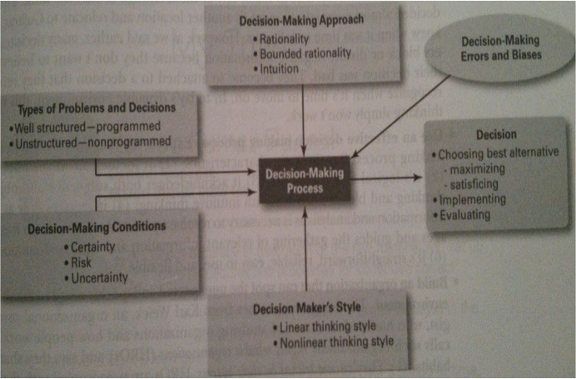
Overview of Managerial Decision Making

